Slide 1





ComplyBook
Compliance-grade financial platform for nonprofits & government contractors
AI-Powered. 70% less bookkeeping. Finally compliant
MARCY FREEBURG | FOUNDER & CEO
TECH@JANDMSOLUTIONS.COM

Slide 2

Problem - The Pain is Real
Target Customers - Small non-profits (<$5M revenue) & small government contractors (<$25M revenue)
QUANTIFIED PAIN
FAILED ALTERNATIVES
MACRO TREND
8-12 hours/week lost on manual reconciliation
$6k-$20k/year in audit corrections & penalties
5-10% of revenue at risk from DCAA or grant non-compliance
65% of non-profits are still stuck on Excel or QuickBooks
QuickBooks → Not DCAA Compliant
Aplos /Blackbaud → $500 - $2,000/month
Excel → error-prone, no audit trail
Rising IRS reporting
Rising government reporting
Compliance chaos

Slide 3
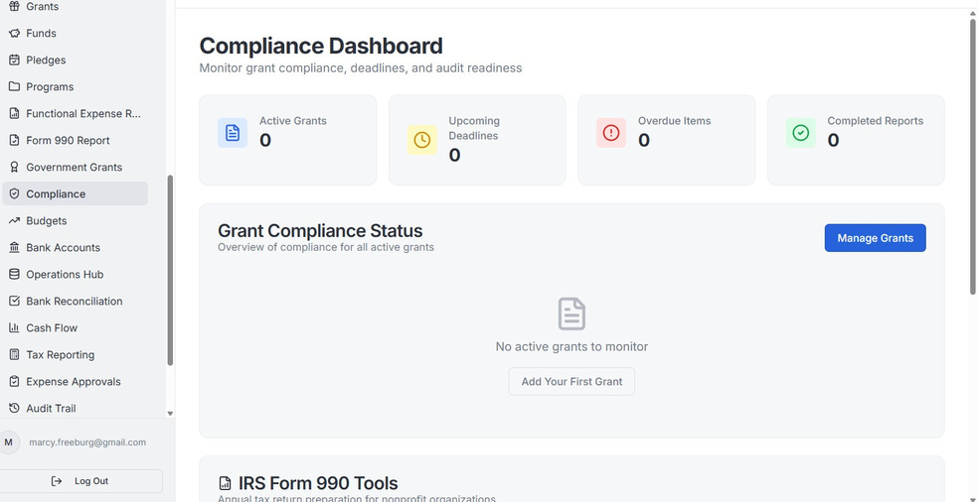
Solution - One platform that finally works for both worlds
ComplyBook cuts bookkeeping 70% with built-in AI compliance
3-STEP FLOW
SCREENSHOT
COMPETITIVE EDGE
Connect banks & import (Plaid + CSV)
AI Auto-categorizes & reconciles
One-click compliant reports (990, SF-425, DCAA, Incurred Cost, etc)
NIST/CMMC-ready secuirty
Built for non-profits + GovCon from Day One
50-70% less expensive than Blackbaud, Aplos, Deltek

Slide 4
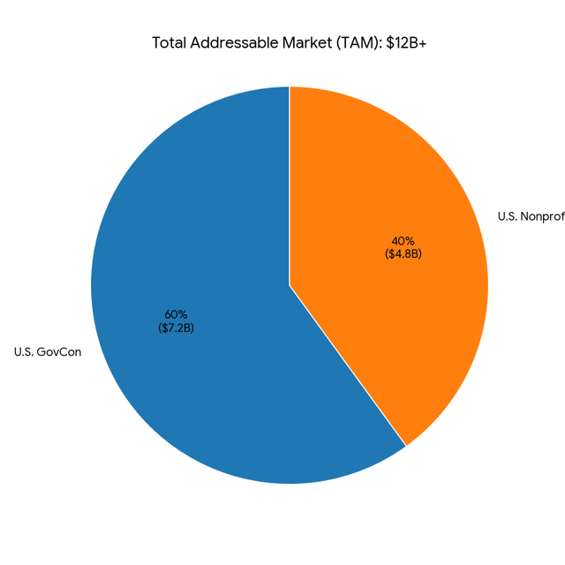
Market Opportunity - $12B+ Global Market - Perfect Timing
Beachhead ~ 450,000 U.S. Small non-profits + 150,00 small GovCon firms
SAM (2025) $2.5B - $3.5B (U.S. only)
TAM $12B+ global non-profit +GovCon compliance Software
Expansion Path → U.S. Small → mid-size → enterprise GovCon → international
Catalysts
AI automation wave
Grantors demanding real transparency
Additional government reporting

Slide 5

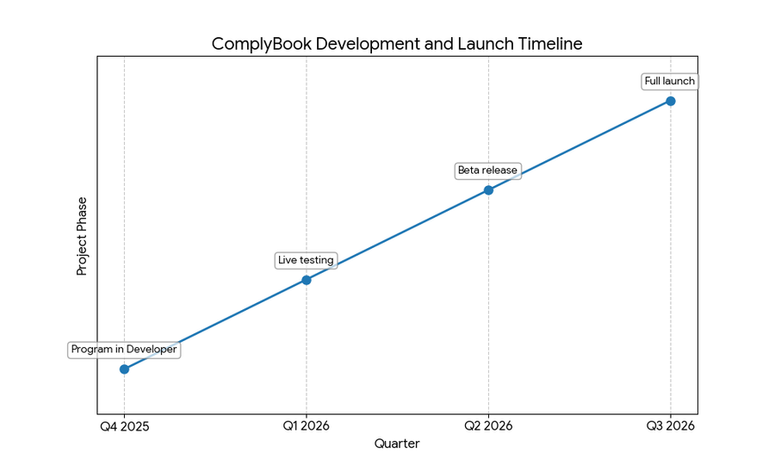
Traction & Validation - Product is 95% production-ready
Product Status
Next 30-60 Days
98/98 Core Features Complete
All major workflows tested - Plaid Sync, AI Categorization, Full Reporting, MFA
Currently undergoing testing in developer mode
Finish Developor Testing
Testing with live data
Test group of 10 companies
First Revenues

Slide 6
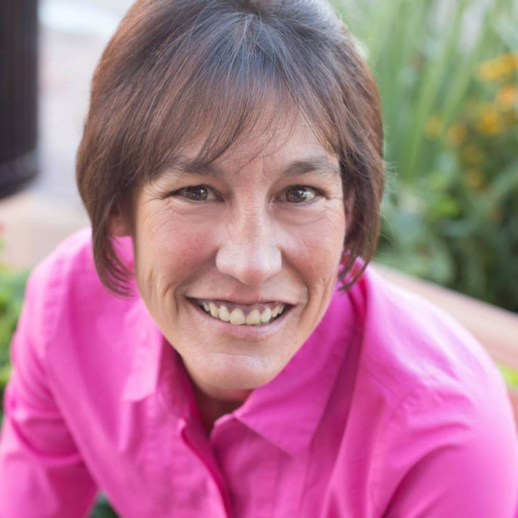


Built 100% of the product solo
CMMC Registered Practitioner + Master’s in Cybersecurity Law
10+ years living the pain
Marcy Freebug
The Ask
Founder
Raising $75,000 on a SAFE ($3M pre-money valuation)
12-month use of funds
50% Final security hardening & launch
30% Paid pilots + early Sales (Colorado focus first)
15% Part-time Sales/ Compliance support
5% Ops & reserves

Slide 7
Get In Touch With Us
Email Address
tech@jandmsolutions.com
Phone Number
(719) 252-5167
Location
521 Main Street
Walsenburg, CO 81089

